Slide 1

Credit Risk Scoring
August
2019
Notes:
creditworthiness is very important for everyone since it is regarded as an indicator for how dependable an individual is. In various situations, service suppliers need to evaluate customers’ credit history first, and then decide whether they will provide the service or not. However, it is time-consuming to check the entire personal portfolios and generate a credit report manually. Thus, the credit score is developed and applied for this purpose because it is time-saving and easily comprehensible

Slide 2
Contents
Primer
Project Objective
Methodology
Data Lookup
Exploratory Data Analysis
Woe and IV
Model Training
Conclusions
Issues & Future improvements
Notes:
For a bank or financial institution, the misclassification cost of not predicting loan defaults correctly is much higher than misclassiffication cost of not predicting non-defaults correctly, hence it is important that the model should have a higher sensitivity.

Slide 3

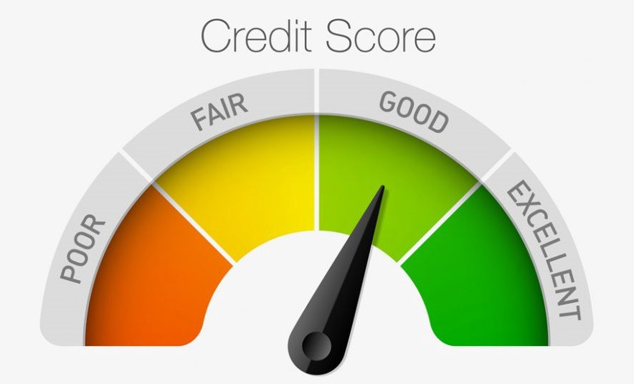
Credit Risk Score
Why do we need it ?
Numerical expression based on statistical analysis of a person’s data to measure one’s creditworthiness
Banks and financial institutions use credit risk score to
evaluate risk posed by lending money to consumers
determine who qualifies for a loan
forecast if customer is going to default
find the customers bringing most revenue

Slide 4

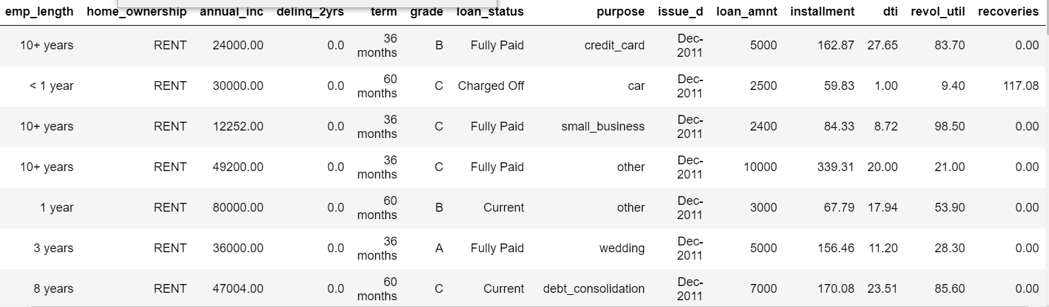
Case study Introduction
Objective :
To predict which customer is going to default
Finding key factors from Data
-Borrower Information: Information on the customers
- Loan Classification Information: Information on the actual loans
- Loan Payment Information: Information on the payments on the loans.
Data :
Total 887K approx. records with 68 columns after merging all the input files.- no duplicates.
Date Range -2007 to 2015

Slide 5

Methodology
Data Pre-Processing
Feature Engineering
Model Building
Business understanding
Exploratory Data Analysis
Data Cleaning
Identifying Features and Labels
Model Development
Data split
Model Training
Evaluation with Accuracy
Comparison
Data Binning

Slide 6
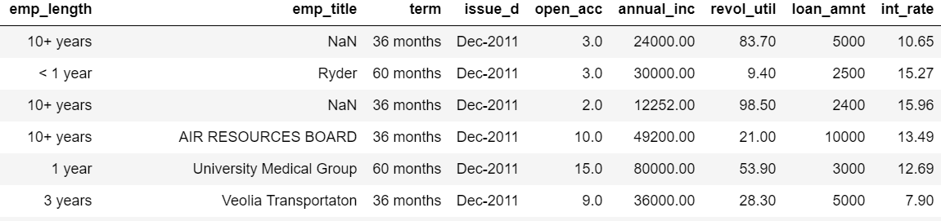
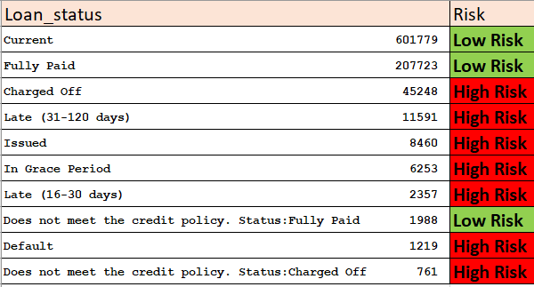
Data Lookup and Cleaning
18 columns found having 80% values as null , were deleted
Handling missing values in text columns replaced by ‘ Missing’ text.
Text Stripping in numerical columns like ‘months’ or ‘ years’.
Variable Binning for Annual income,
income , term.
Outlier Detection.
A new label is created using ‘ Loan Status’ column.
29 records that have relevant columns like open_acc, toal_rec,
acc_no, delinq_2_yrs containing null values, were removed .
Transformation of Date Columns
Notes:
29 records that have relevant columns like open_acc, toal_rec, acc_no, delinq_2_yrs containing null values, were removed .
Date Columns were transformed into better values

Slide 7
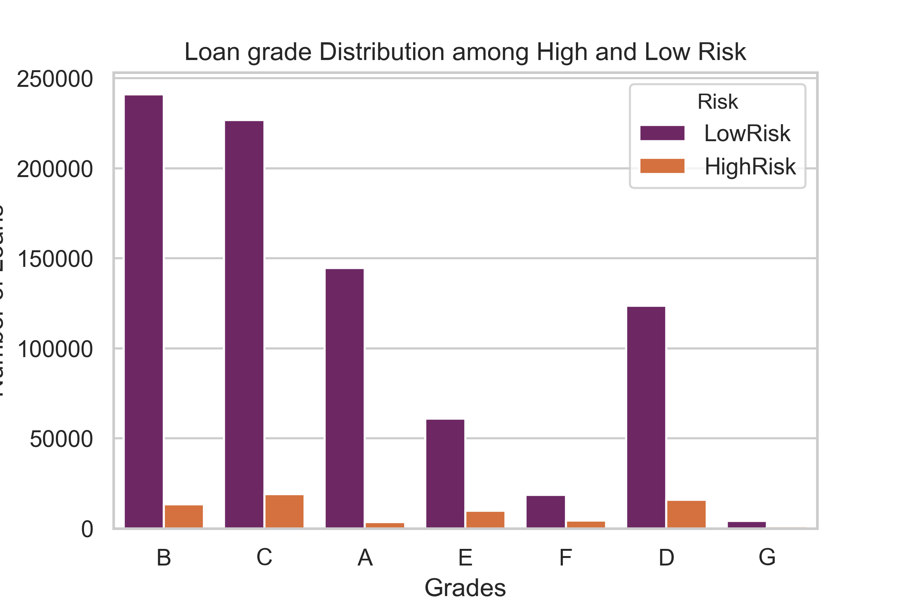
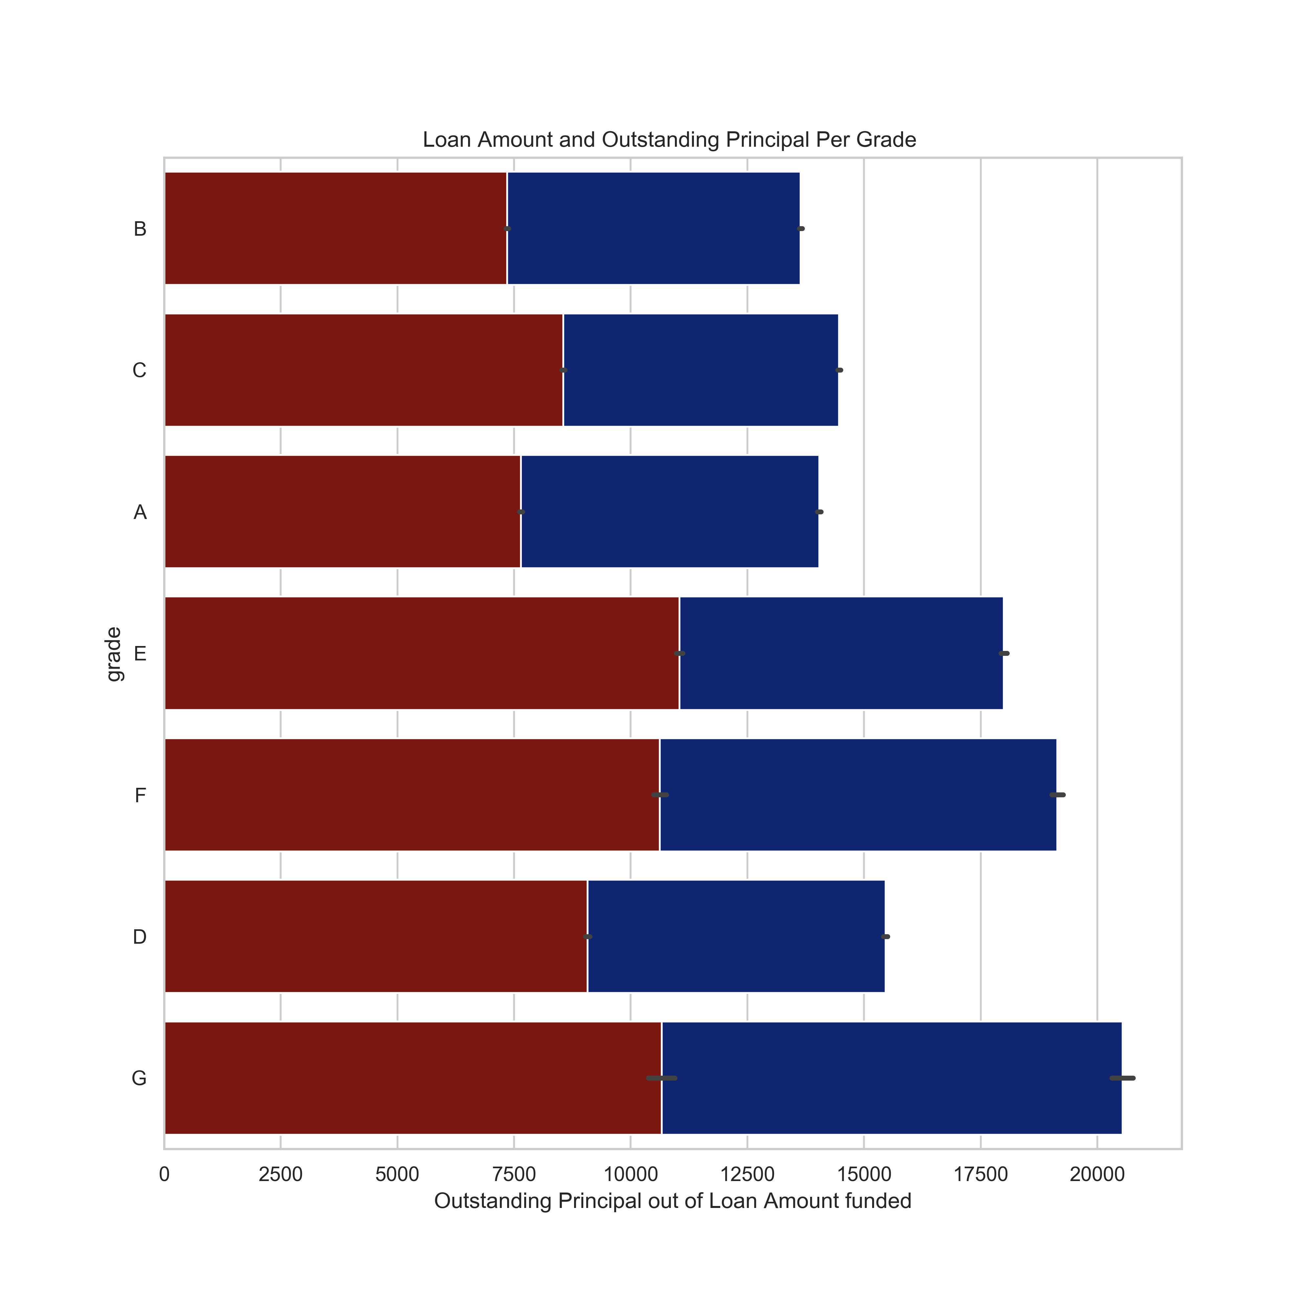
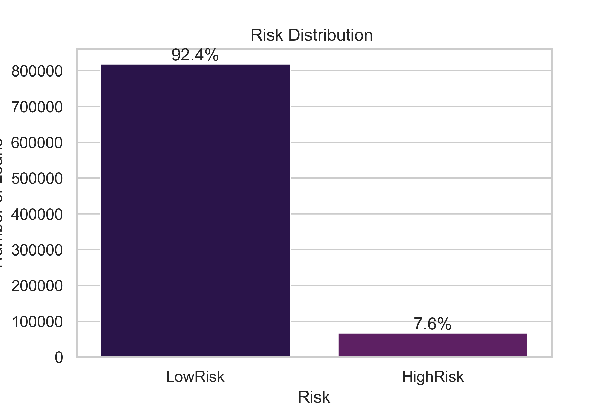
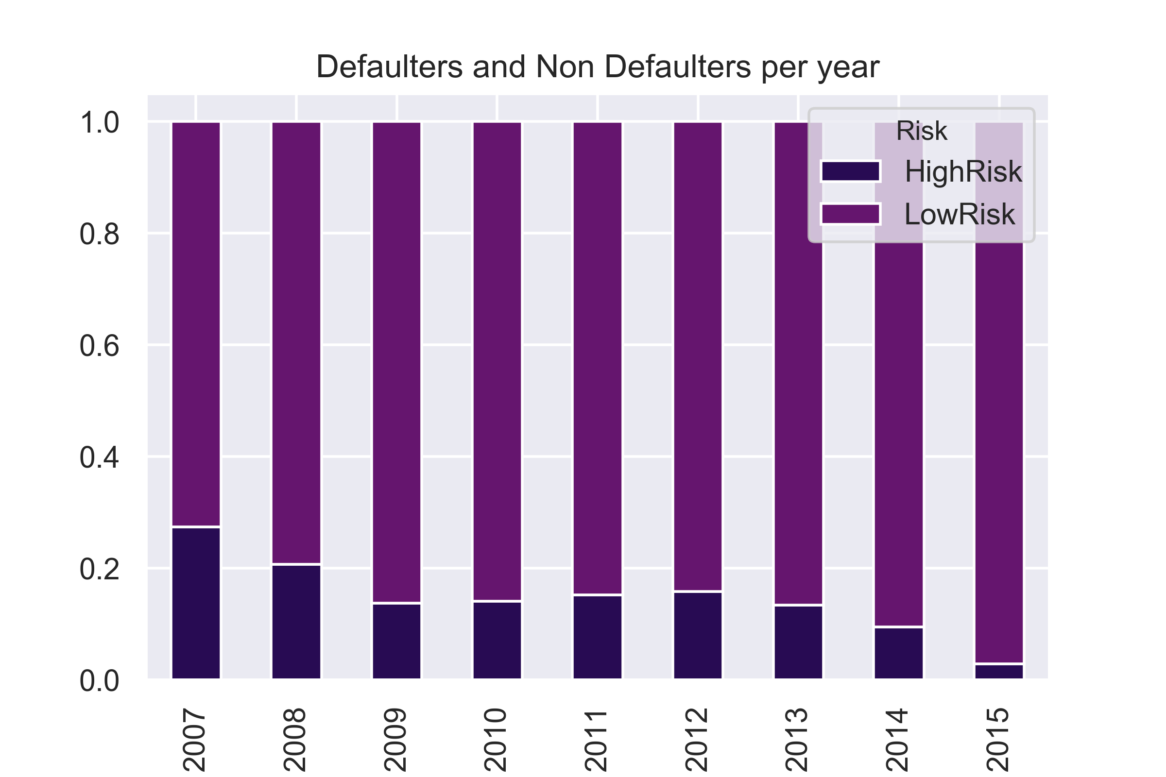
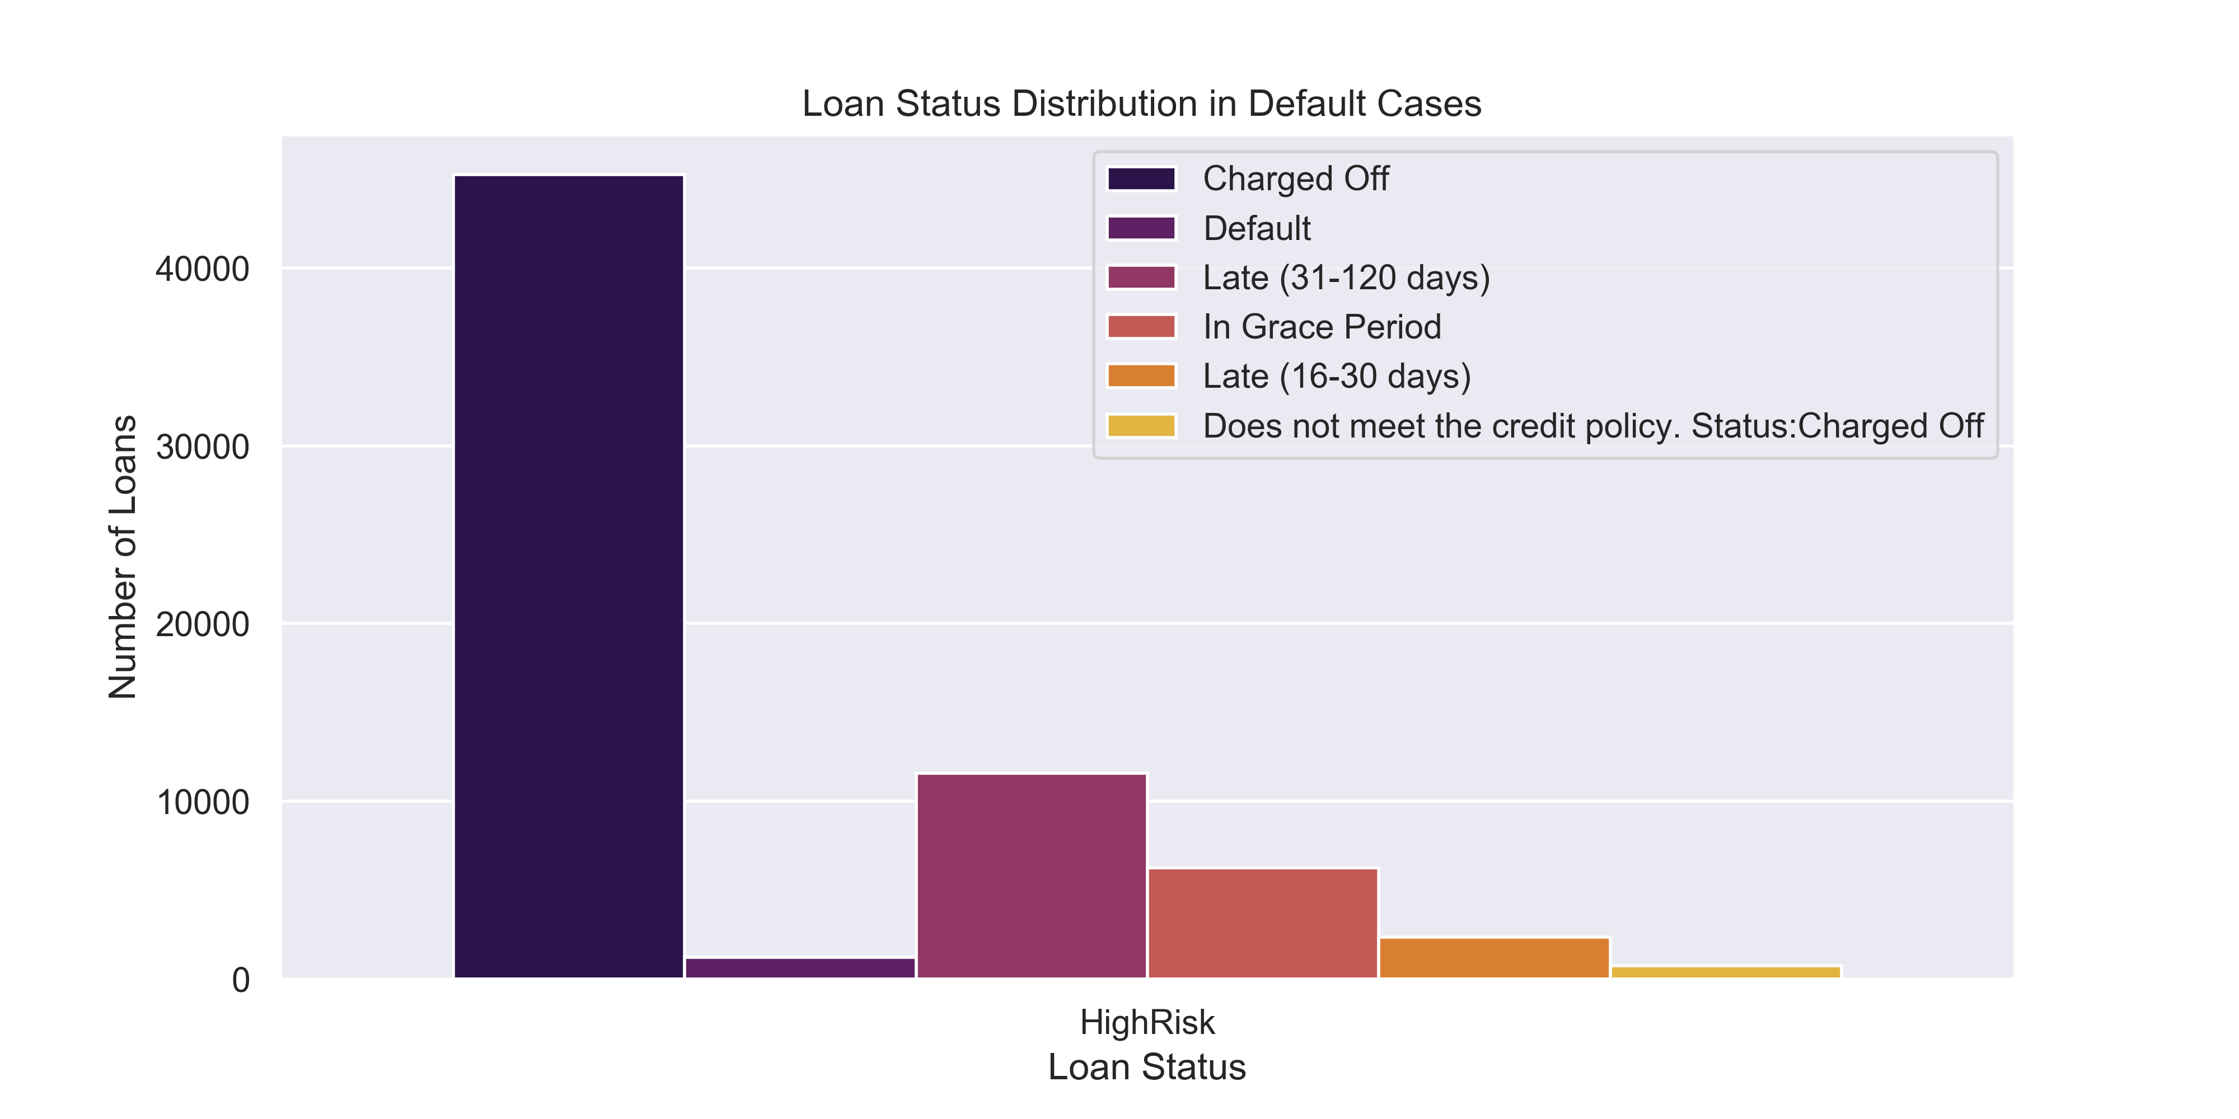
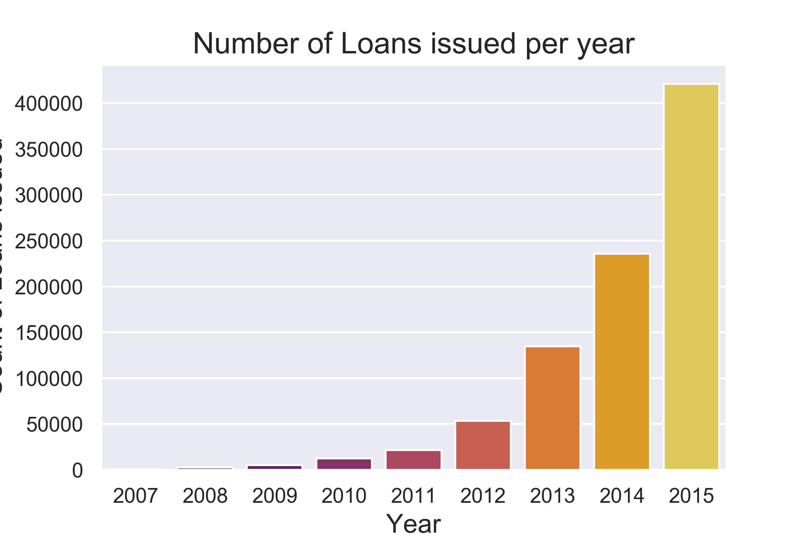
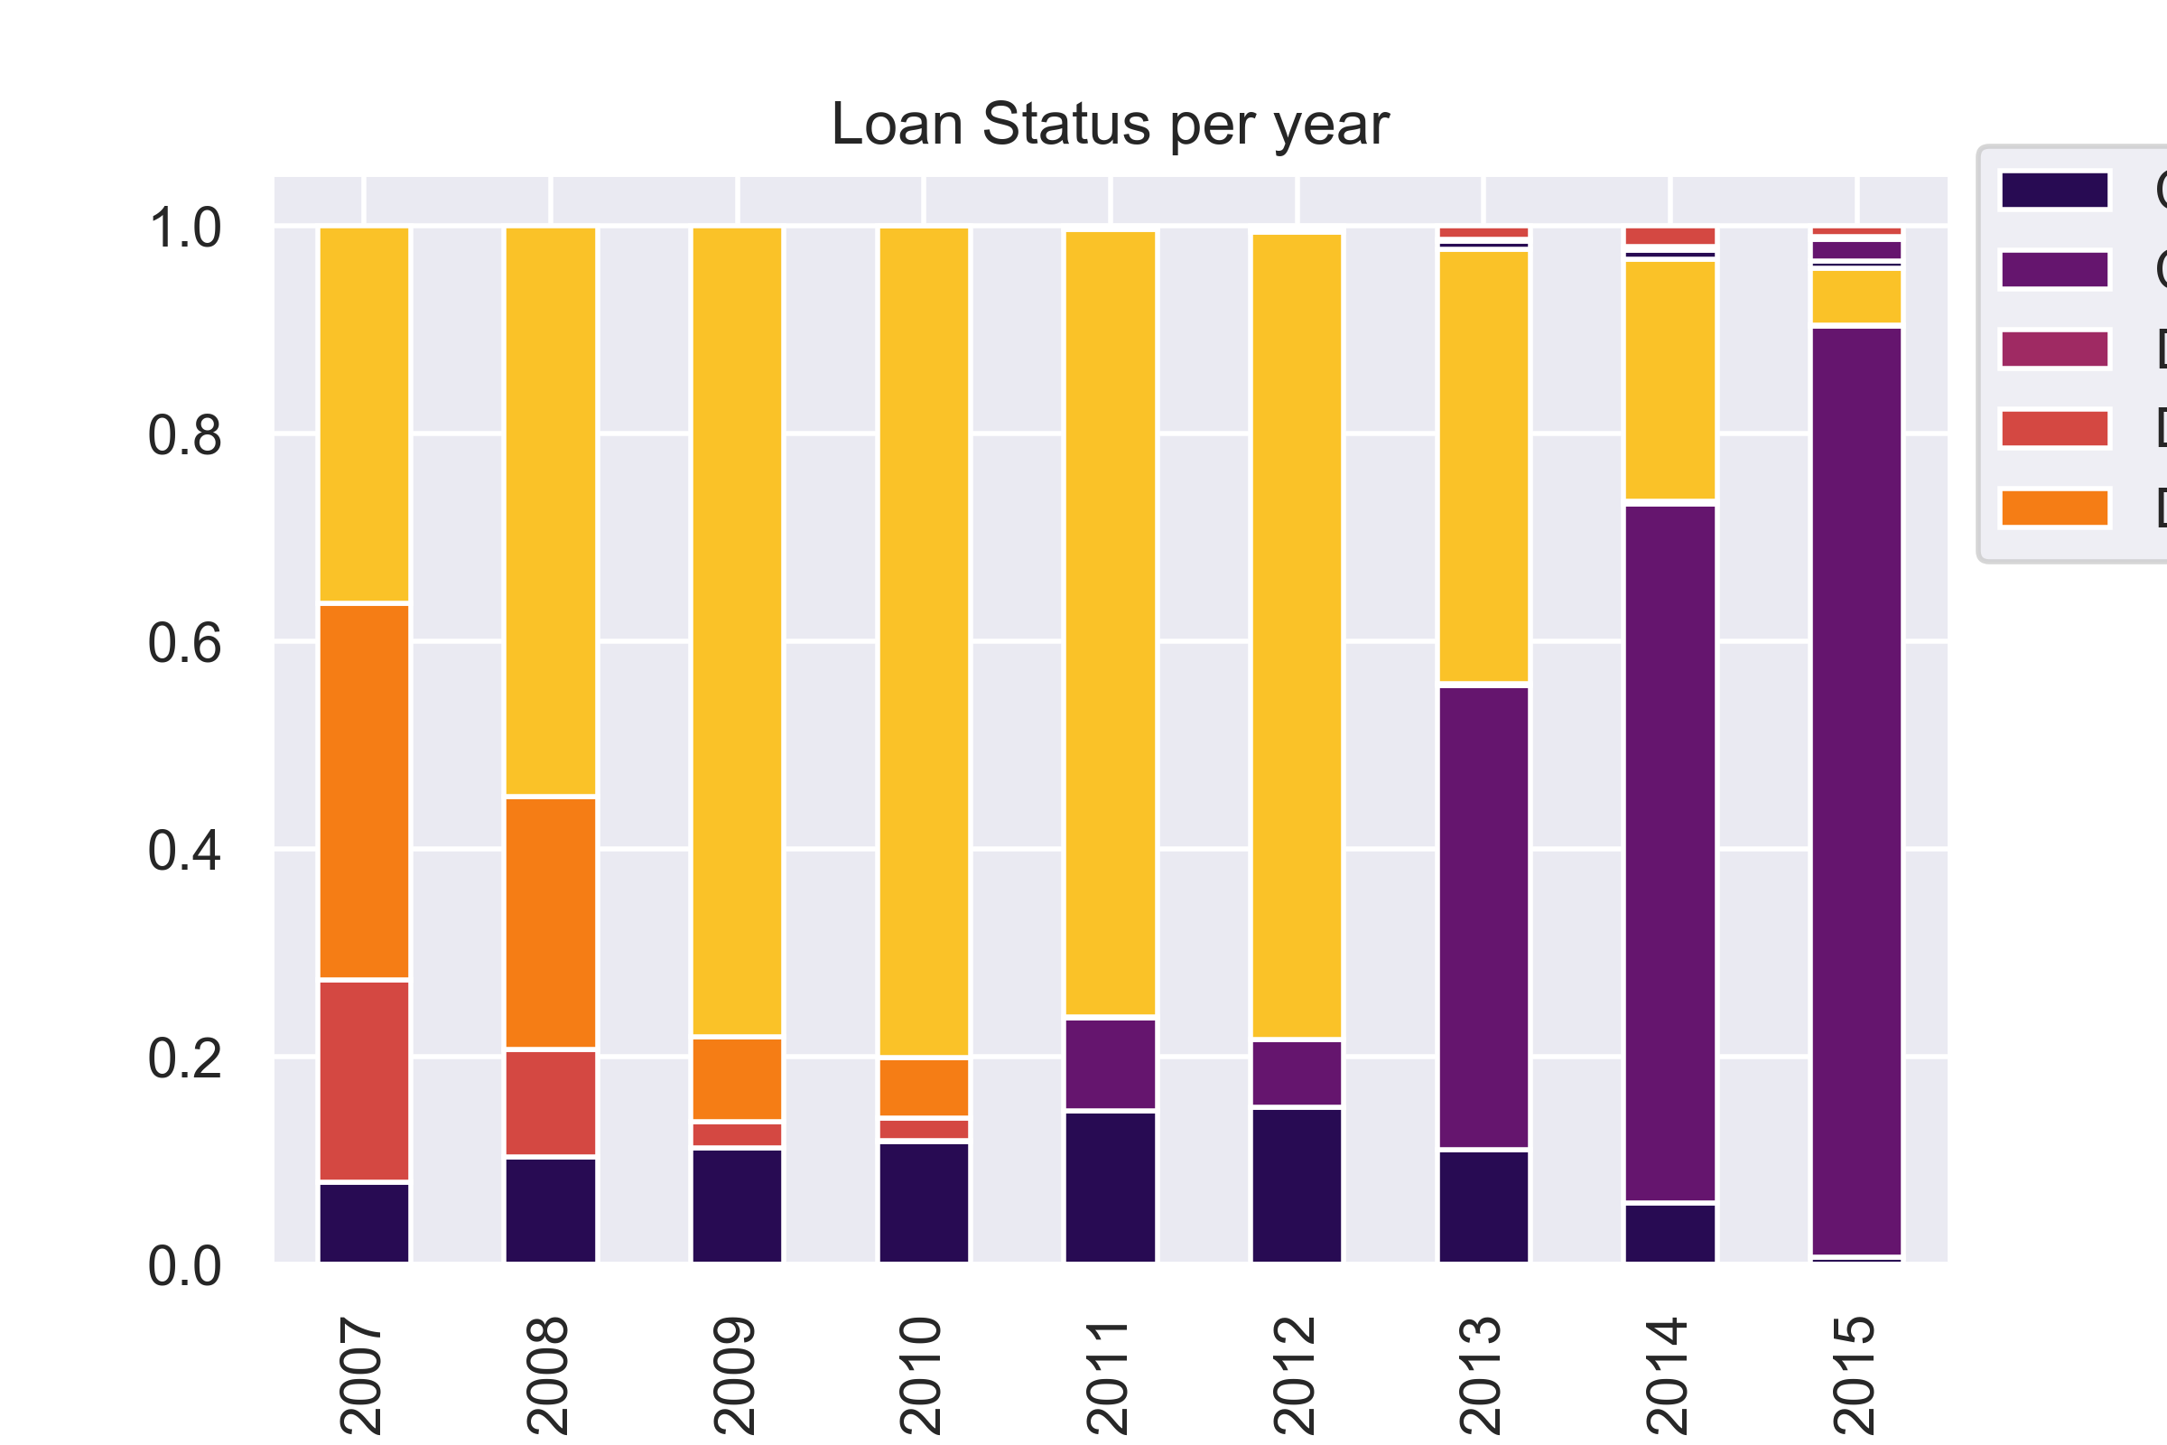
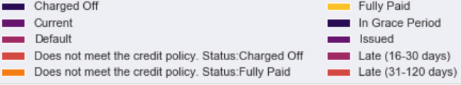
Exploratory Data Analysis
Risk Distribution among Loan Grades
Number of Loans Issued Per Year
Risk Distribution
Loan Grades B and C constitute approx. 50% whereas C and D grade loans seemsto be defaulting more.
92% are Low Risk and only 7% records are High Risk.Out of Those 7% High Risk, more than half are Charged Off loans , whereas17% are late by 3 months
Number of loans issued are rising exponentially since 2010. Loans in 2015 consume 47% of the whole data. The loans that were issued in 2013 and 2014 have defaulted more in number as compared to 2015.

Slide 8
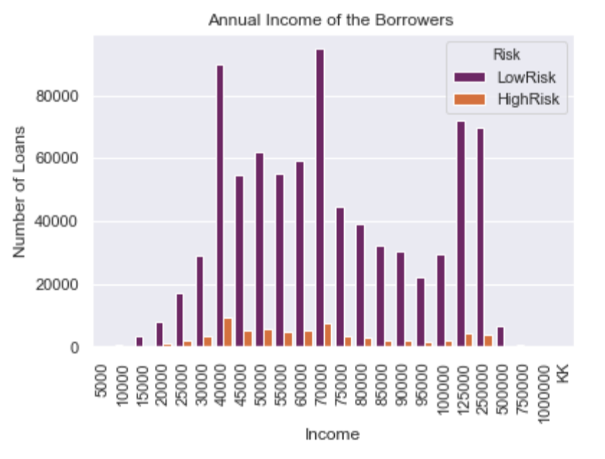
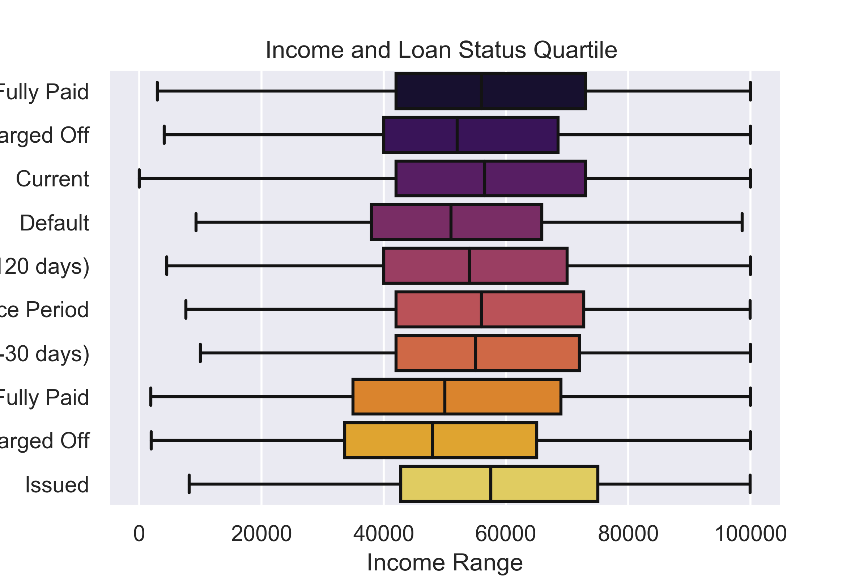
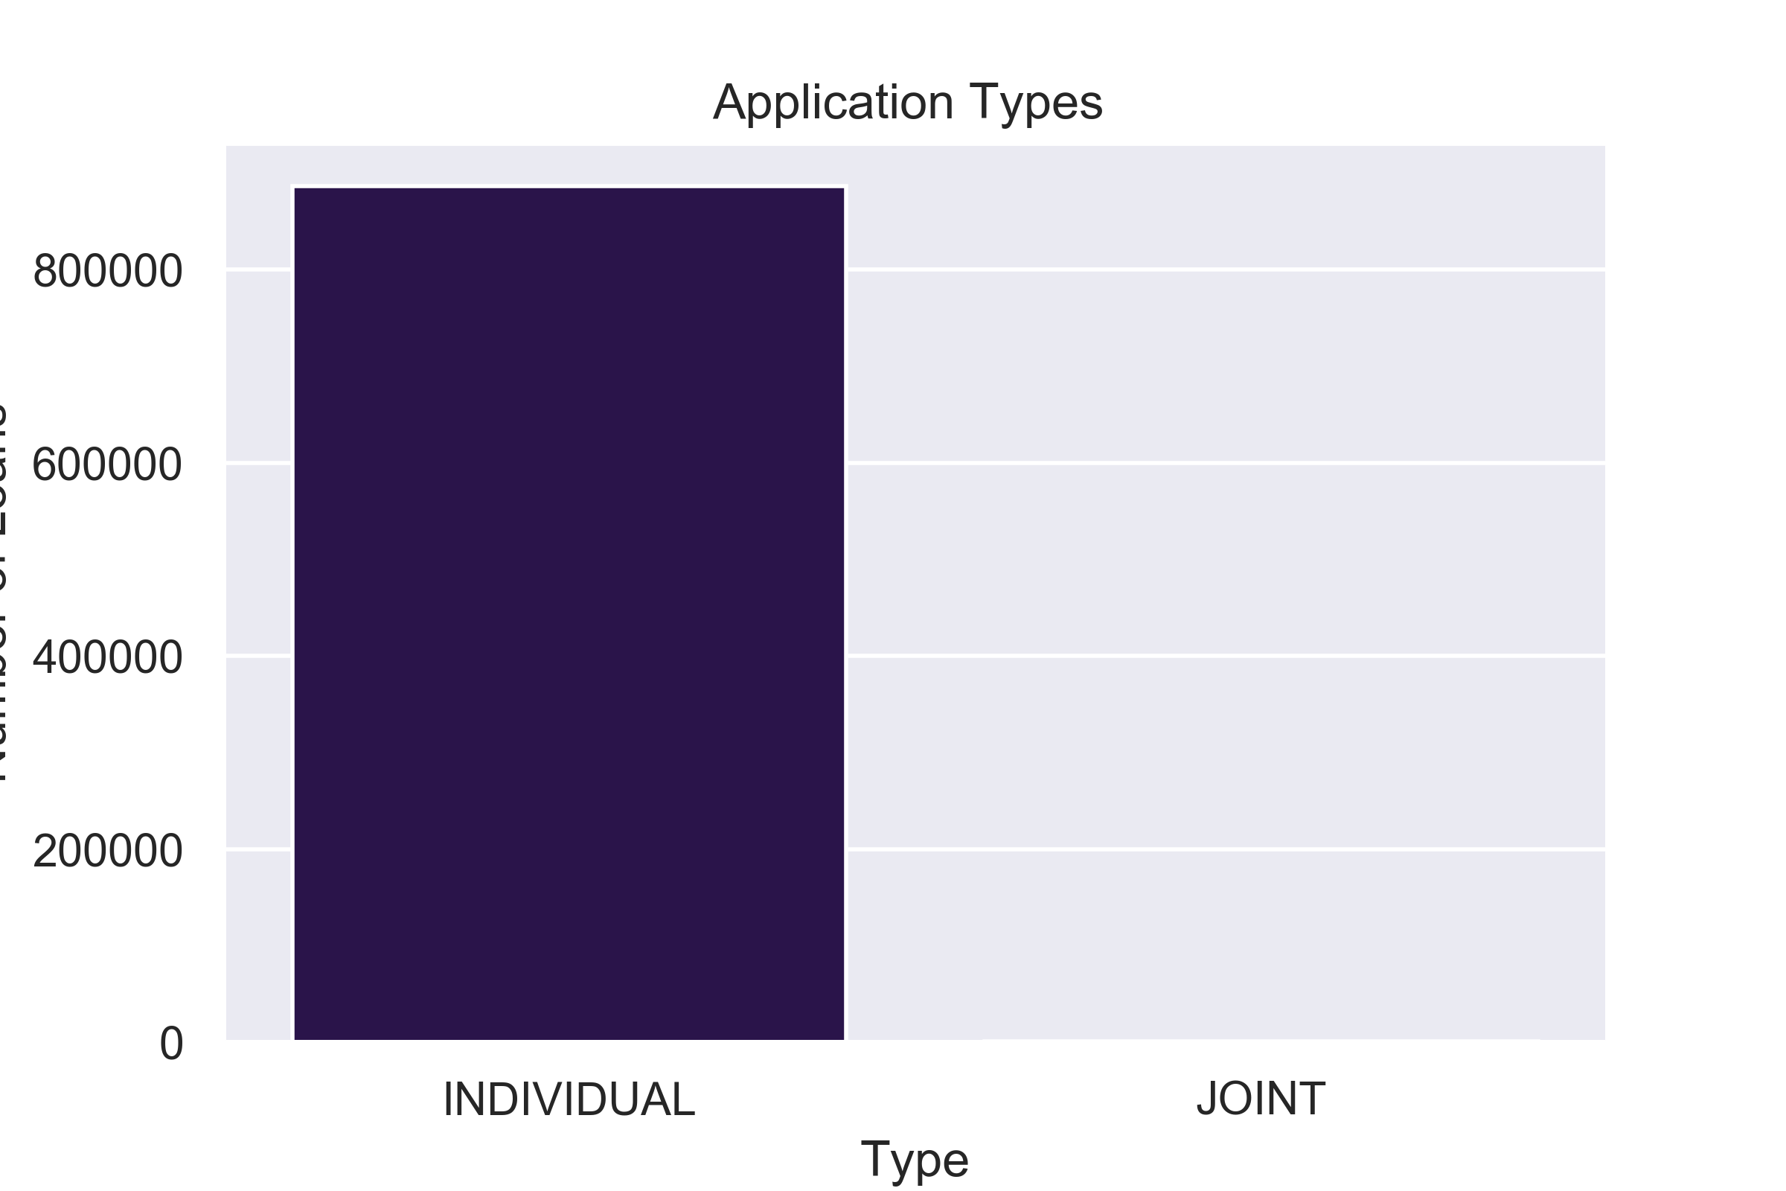
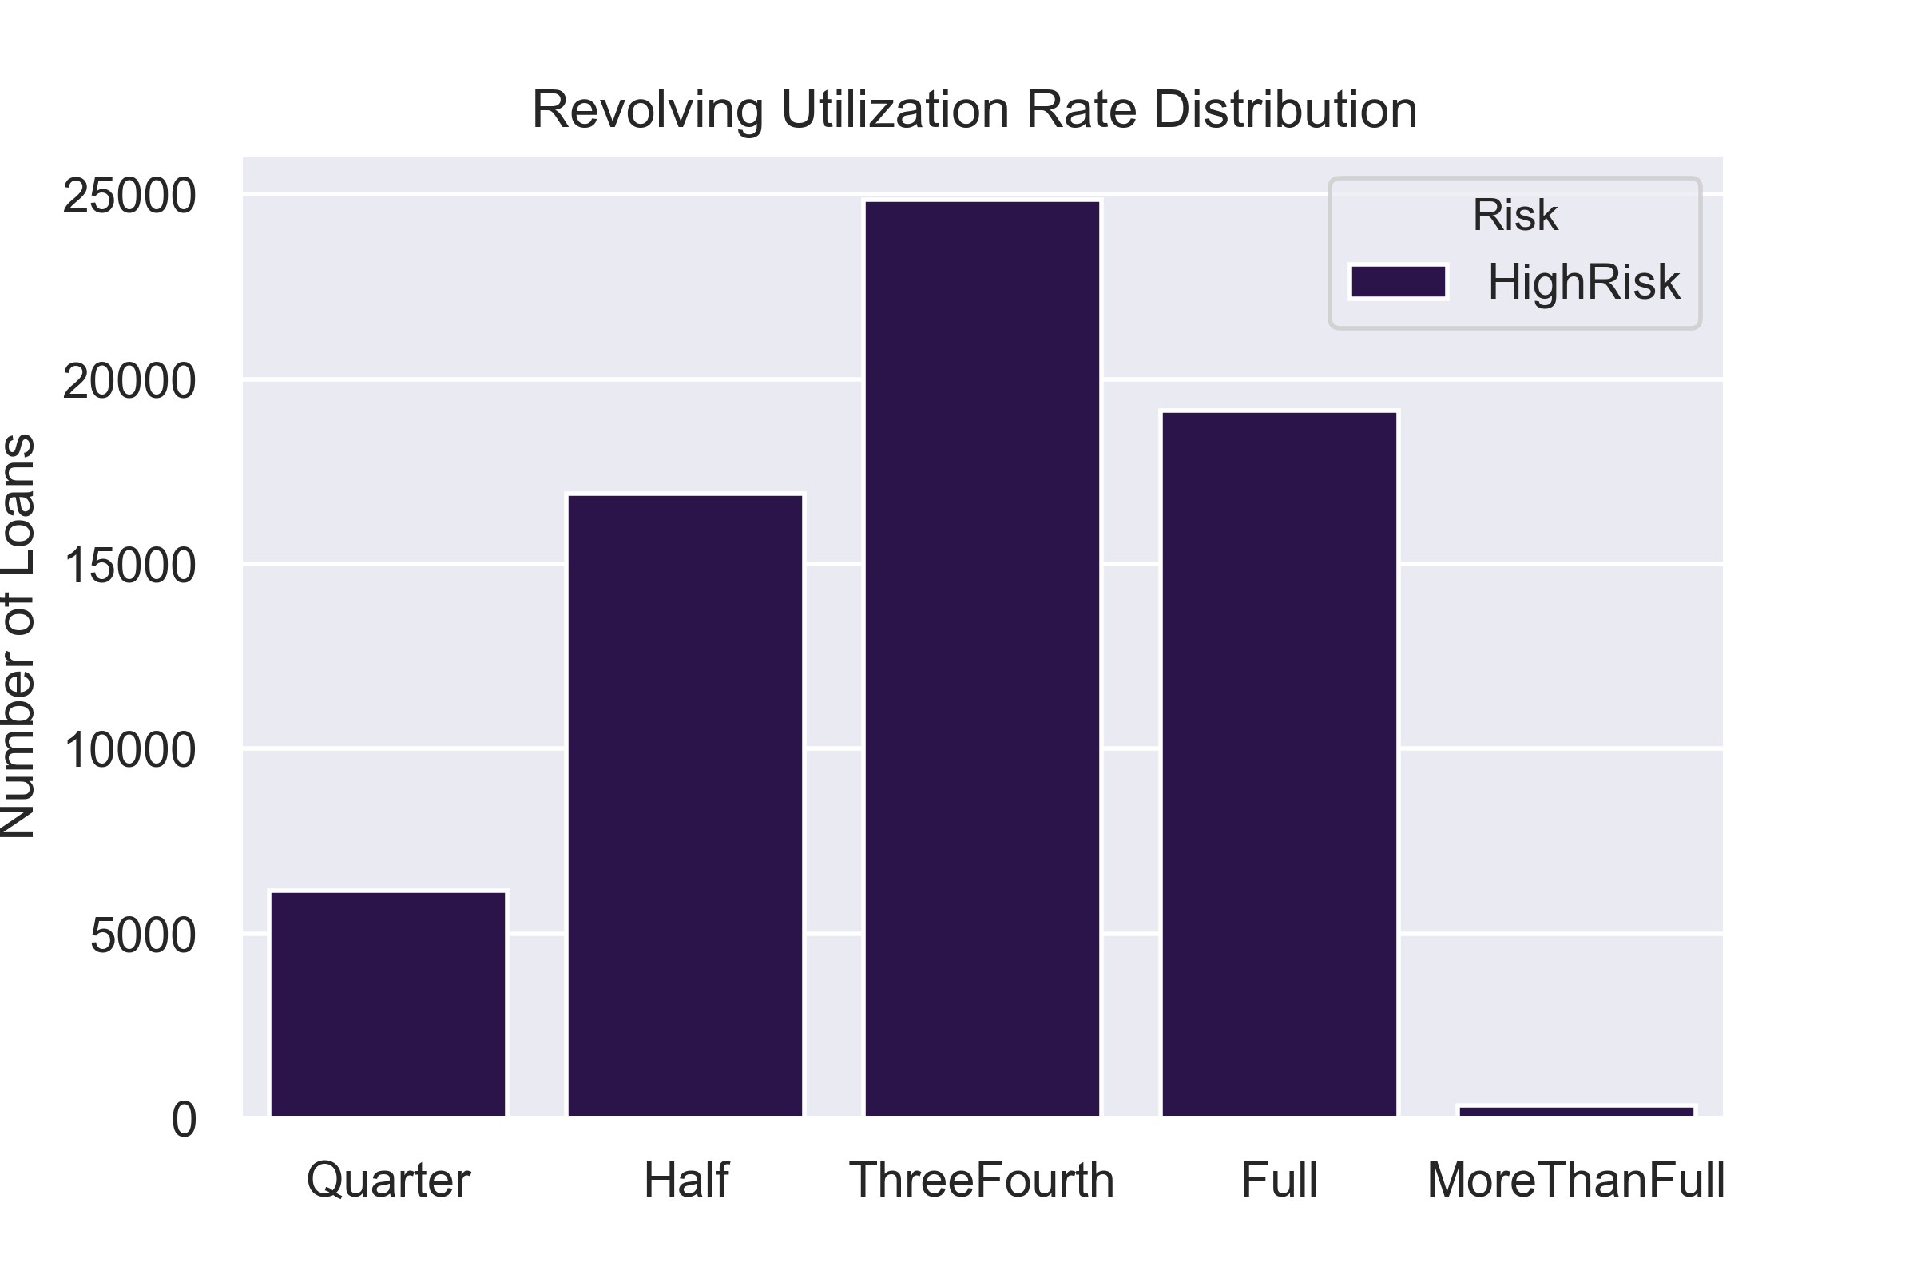
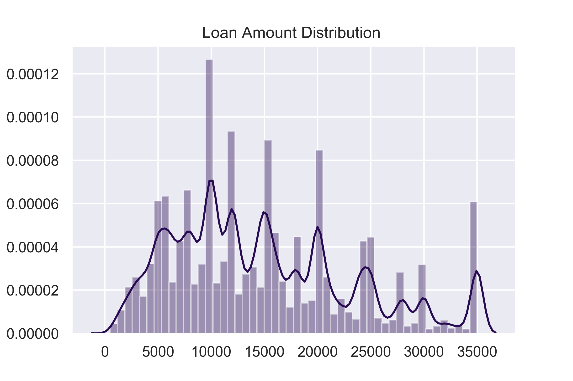
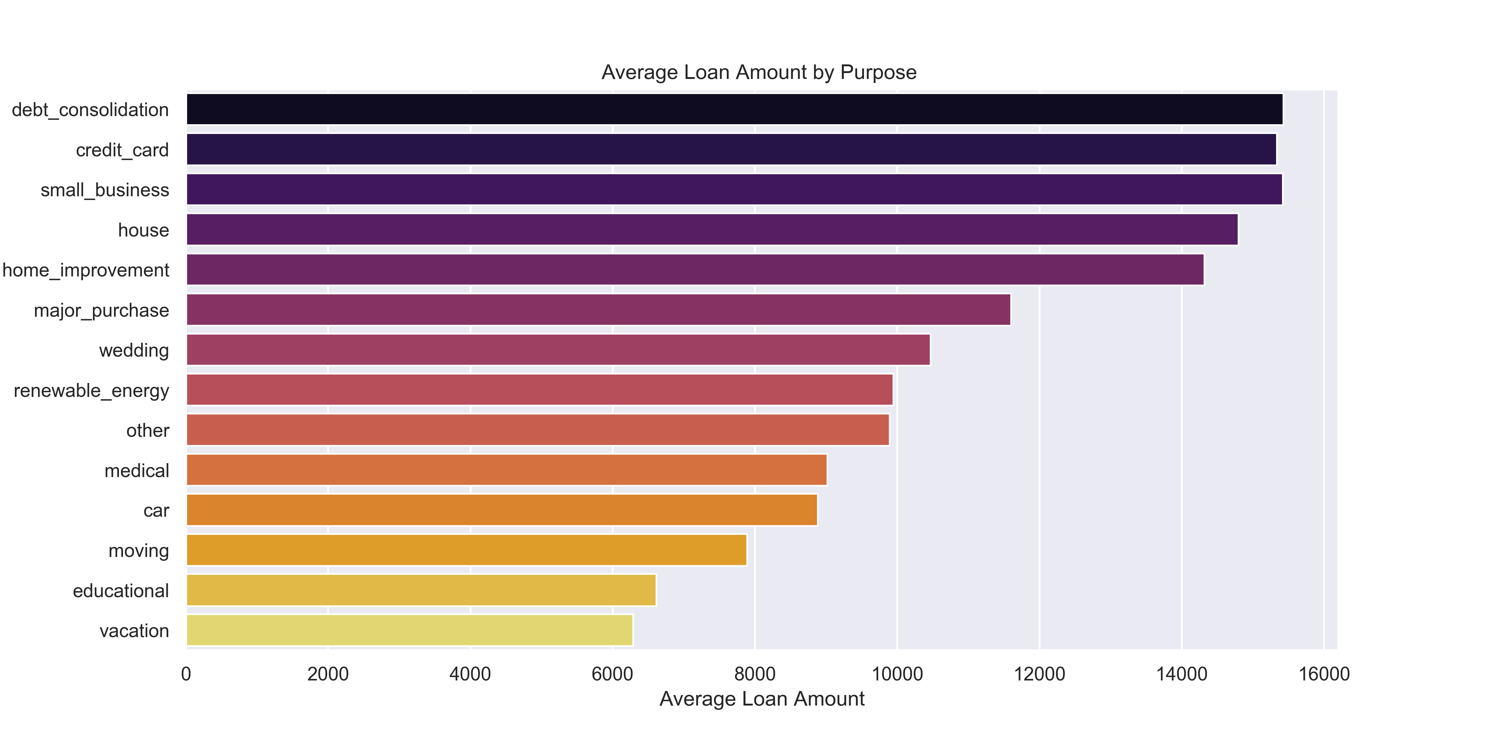
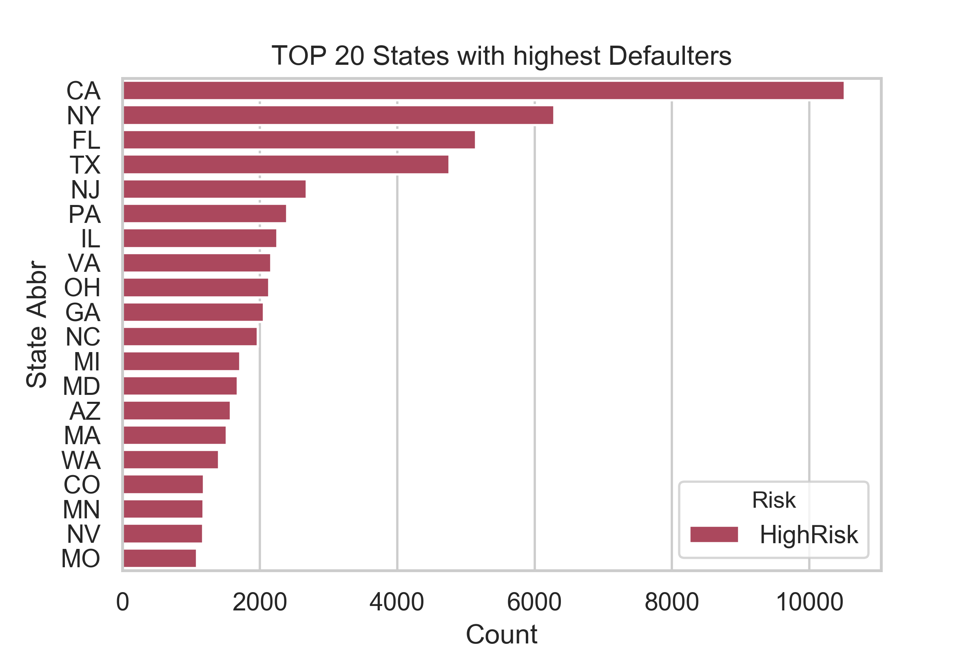
Exploratory Data Analysis
Loan Amount Distribution and Purpose
Application Type and Revolving Utilization Rate
States with highest Defaulters
Annual Income , Risk and Loan Status
Debt Consolidation purpose with more 58% from the total. Others: Credit Card — more than 20% .Home Improvement — more than 8% Other Purposes — less than 3%
Top 10 states with highest defaulters are California having 14% loans including 1% defaulters.
Annual Income is highly Skewed and highly peaked .

Slide 9
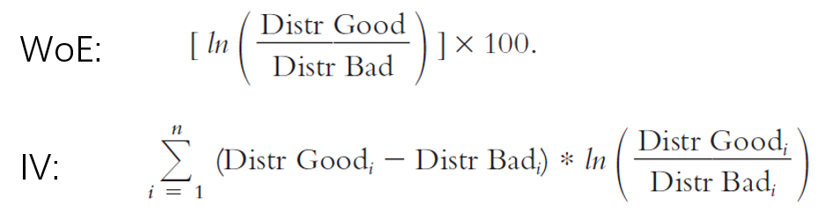
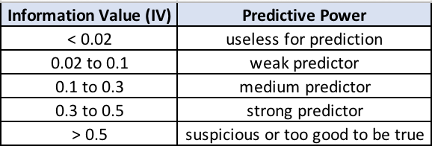
Weight of Evidence & Information value
Weight of Evidence (WoE) is exactly to assign a unique value to each group of categorical variables.
The Information Value (IV) measures predictive power of the characteristic, which is used for feature selection.
The formula of WoE and IV is given below. Here the “Good” means the customer won’t have serious delinquency “Bad” means the customer will have serious delinquency

Slide 10
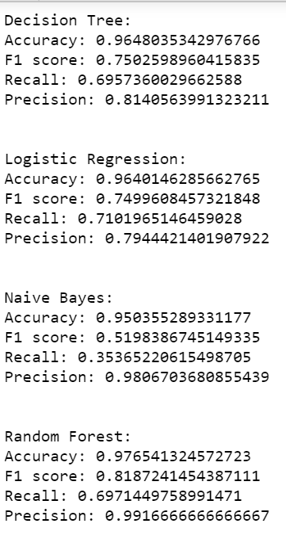
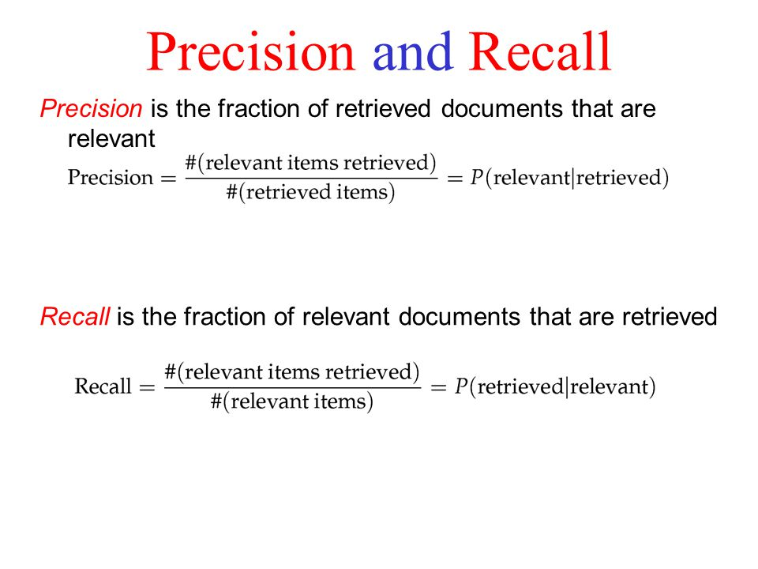
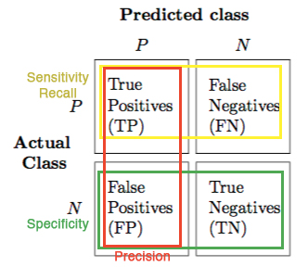
Model Training
& Evaluation
Machine Learning Models implemented are:
1.Logistic Regression
2.Decision Tree
3.Random Forest
4.Naïve Bayes
Data Split is done in 80:20 Ratio
Stratified Shuffle Sampling is implemented
Accuracy can be compromised but not Sensitivity
Notes:
For a bank or financial institution, the misclassification cost of not predicting loan defaults correctly is much higher than misclassification cost of not predicting non-defaults correctly, hence it is important that the model should have a higher sensitivity.
and Accuracy

Slide 11

Conclusions
92% are low risk and 67% of them are ‘ Current’. Meaning There is a risk that they can turn into bad loans. Only 7% cases are High Risk. From early 2013 until mid 2014, we can see a boom in loan applications volume, only to see a violent drop in defaulters after this period.Loan applications were rising and loan defaults were diminishing.
Only Individuals are applying for Loans and Their Annual income lies not more 200K dollars .Very least population is earning great salary.
Most of the values in Emp Title were none .Perhaps Bank has been giving loans to unemployed people or the value is mistakenly missed.
Debt Consolidation and Credit card purposes make 85% of the whole set ,maintain the top position in Loan amount too .But Small business covers only 1% of the cases yet maintains third position in highest average loan amount in comparison to House loans.
Revolving Utilization Rate lies between 25% - 100% for all the defaulters. It can be used to monitor the borrower's accounts . The bank can keep a close eye on the account and can be alarmed once the borrower's utilization rate reached Three Fourth cluster.
50% of the customers are having mortgages for their houses whereas rest 40% in rent and 10% in their own .
Not able to bring value : Loan Duration (either 2.5 year or 5 years),Customer’s Employment duration (which More than 10 years in , Debt to Income Ratio .
Delinquency in 2 years Feature was expected to bring limelight but almost 82% are never late in paying the installements .perhaps this is because of the imbalanced data.
There seems to be a correlation between Interest rate, revolving utilization Rate, Loan Duration.

Slide 12
& Future Improvements
Issues
Imbalanced Dataset -with Label having only 7 % in the data.
Missing Values – many columns have Nan value or 0 values
Appropriate Values for the Text Column for Binning
Business Interaction required to understand the value of the information
Implementation of Advanced Machine Learning models like XGBoost, Neural Networks,PCA, SVM.
Better metrics for quality like Gini Index can be implemented.
GeoMap Library for visualization of the states.
Better and optimized Sampling Strategy to overcome Imbalance.
Optimization by hyperparameter tuning.
More features from the borrower’s file can contribute a lot .

Slide 13


THANK YOU!
Q & A
Kanika Sharma

